Slide 1
Bartenwerfer v. Buckley 598 US _ (2023) DOCKET NO. 21-908
April 7, 2023 Bankruptcy Bench Bar

Slide 2
Background / Facts
Bartenwerfers formed a legal partnership to undergo the repairs. Husband David made important decisions; Wife Kate was mostly unaware
Purchaser, Mr. Buckley, discovered defects after buying and sued Bartenwerfers
State Court Jury awarded damages for Buckley
Bartenwerfers filed for bankruptcy
Buckley filed AP - arguing that the state-court judgment could not be discharged in bankruptcy because the debt was obtained through fraud

Slide 3
Posture
Bankruptcy Court agreed with Buckley
Found Bartenwerfers intended to deceive Buckley,
Mr. Bartenwerfer had actual knowledge of the factual misrepresentations,
Partnership relationship and imputation of fraud.
Ninth Circuit Bankruptcy Appellate Panel - Remand
Instructing court to determine whether Kate knew or had reason to know of the fraud
The U.S. Court of Appeals for the Ninth Circuit
reversed and remanded, concluding that the bankruptcy court applied the incorrect legal standard for imputed liability in a partnership relationship.
is whether the fraud was performed “on behalf of the partnership and in the ordinary course of business of the partnership.”

Slide 4
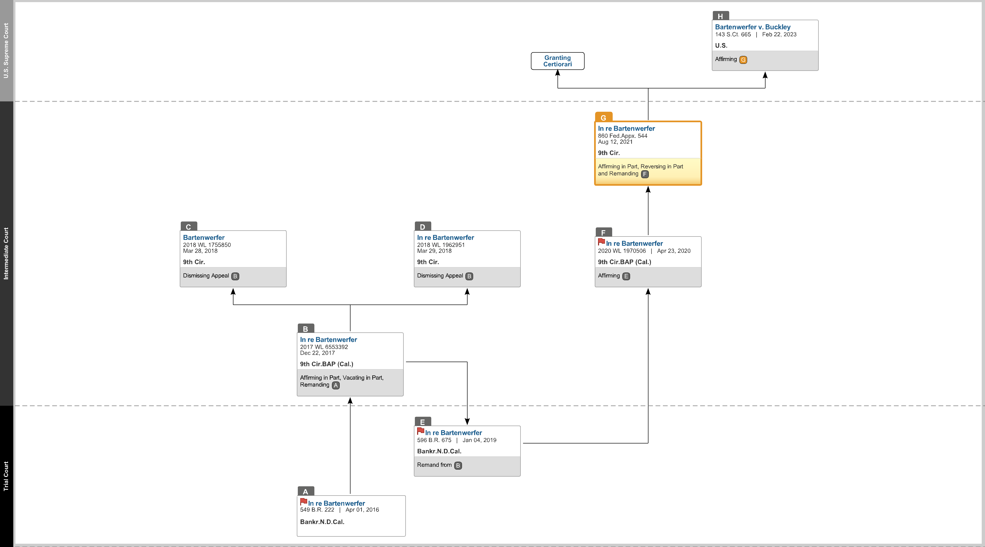

Slide 5
SCOTUS Issue & Holding
Issue
Can a bankruptcy debtor be held liable for another person’s fraud, even when they were not aware of the fraud?
Holding
Yes, a debtor who is liable for her partner’s fraud cannot discharge that debt in bankruptcy, regardless of her own culpability.
Mrs. Bartenwerfer could not discharge her fraud/debt in bankruptcy, regardless of her culpability

Slide 6
Court’s Reasoning – Barrett
§523 (a) A discharge under section 727, 1141, 1192 [1] 1228(a), 1228(b), or 1328(b) of this title does not discharge an individual debtor from any debt—
(2)for money, property, services, or an extension, renewal, or refinancing of credit, to the extent obtained by—
(A)false pretenses, a false representation, or actual fraud, other than a statement respecting the debtor’s or an insider’s financial condition;
“Passive voice pulls the actor off the stage.”
“The fraud of one partner, we explained, is the fraud of all because ‘[e]ach partner was the agent and representative of the firm with reference to all business within the scope of the partnership.’ ”

Slide 7
Concurrence by Sotomayor & Jackson
“This Court long ago confirmed that reading [referring to the Court’s reading of §523(a)(2)(A)] when it held that fraudulent debts obtained by partners are not dischargeable, Strang v. Bradner, 114 U.S. 555, 559 – 561 (1885). ”
Pointed to agency relationship between the Mr. and Mrs. Bartenwerfer
Mrs. Bartenwerfer did not dispute relationship

